Slide 1
Project 3-Phase 3
Implementation of A* algorithm on a differential drive (non-holonomic) TurtleBot robot (In groups of two)
Deadline – April 25th, 11.59PM

Slide 2
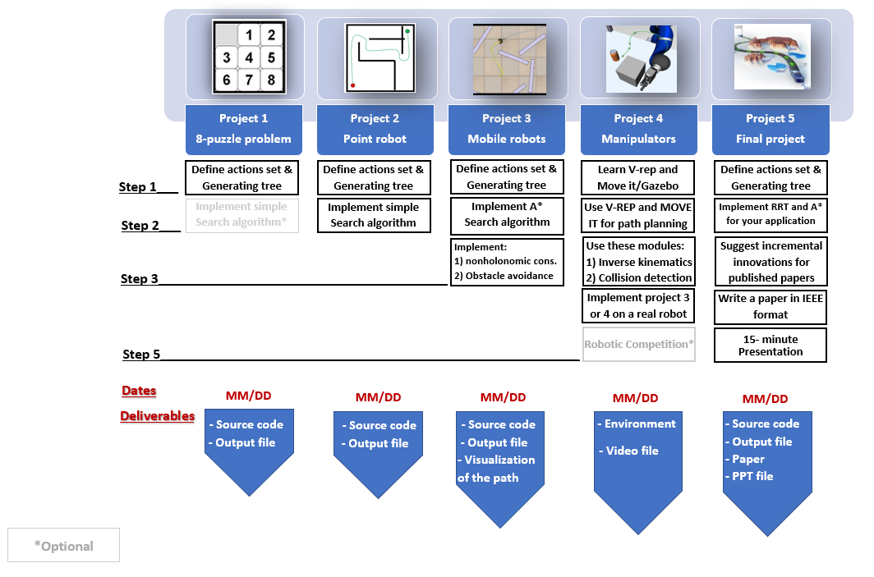
Project3

Slide 3
Project description
Navigate a differential drive robot (TurtleBot 2 / TurtleBot 3) in a given map environment from a given start point to a given goal point.
Consider differential drive constraints while implementing the A* algorithm, with 8 set of action space .

Slide 4
Start
Get the 1) start and goal points from the user; 2) the velocity information; 3) Clearance
Define the action set and obstacle space by mathematical equations
Visualize the free space and obstacle space by ploting lines and curves
Select a data structure type to store open and visited nodes and add the start node

Slide 5
Pop the new parent node from the open list using A* method
Parent Node (popped node) is the goal node
Yes
No
All actions applied then
Apply the (next) action to the parent node
Update the cost and the parent node if necessary
Child Node already exists in the visited list
Yes
Add new node to the open list and visited list and plot action curve
Node is in the obstacle space
No
Yes

Slide 6
Back track from the goal node to start node using child/parent information
Change the color for each curve on the path during the back tracking
Reached to the start node
No
Yes
End

Slide 7
Inputs from the User
Your code must take following values from the user:
Start Point Co-ordinates (3-element vector – x, y, theta)
Goal Point Co-ordinates (2-element vector – x, y)
Wheel RPMs (2-element vector) => Two possible values for the wheel RPMs
Clearance
Note: To simplify path explored, final orientation input is not required.

Slide 8
Parameters to be Defined
Your code must take the following parameters into consideration:
Robot Diameter (from the datasheet)
Wheel Distance –L (to be computed using the datasheet)
Note that, these parameters are not defined by the user. These are the parameters you need to consider while developing the code.
The parameters should be referred from the python file.

Slide 9
Project description (Continued..)
Let the two RPMs provided by the user are RPM1 and RPM2 (shown in next slides). Then the action space for the A* algorithm are:
[0, RPM1]
[RPM1, 0]
[RPM1, RPM1]
[0, RPM2]
[RPM2, 0]
[RPM2, RPM2]
[RPM1, RPM2]
[RPM2, RPM1]
Here the first element corresponds to the left wheel revolution per minute (RPM) and the second element corresponds to the right wheel RPM.
Example: actions=[[50,50],[50,0],[0,50],[50,100],[100,50],[100,100],[0,100],[100,0]]

Slide 10
Step 1) Write a subfunction for non-holonomic constraints
This subfunction will take two arguments (Rotational velocity of the left wheel and right wheel) and return the new coordinate of the robot, i.e. (x,y, theta). Where x and y are the translational coordinate of the robot and theta shows the orientation of the robot with respect to axis x.
A sample is provided in the python file. You may choose to modify the function or implement your own.

Slide 11
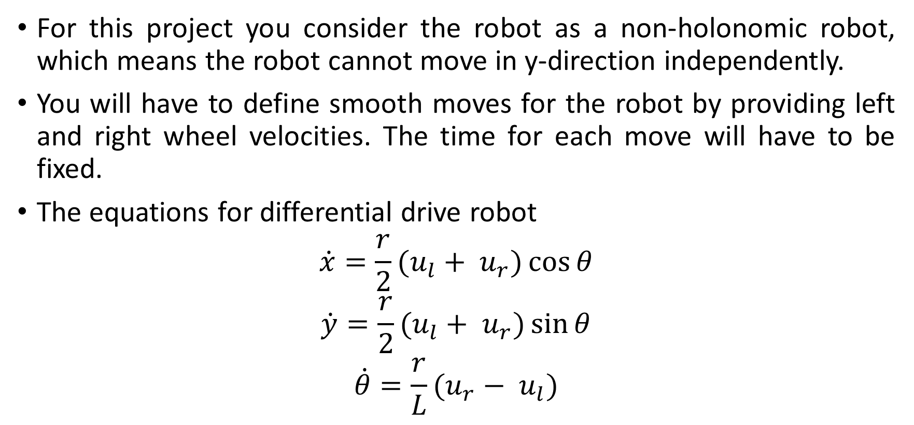
Differential Drive Constraints
For this project you consider the robot as a non-holonomic robot, which means the robot cannot move in y-direction independently.
You will have to define smooth moves for the robot by providing left and right wheel velocities. The time for each move will have to be fixed.
The equations for differential drive robot
$$\dot{x}=\frac{r}{2}(u_{l}+ u_{r})\cos{θ}$$
$$\dot{y}=\frac{r}{2}(u_{l}+ u_{r})\sin{θ}$$
$$\dot{θ}=\frac{r}{L}(u_{r}− u_{l})$$

Slide 12
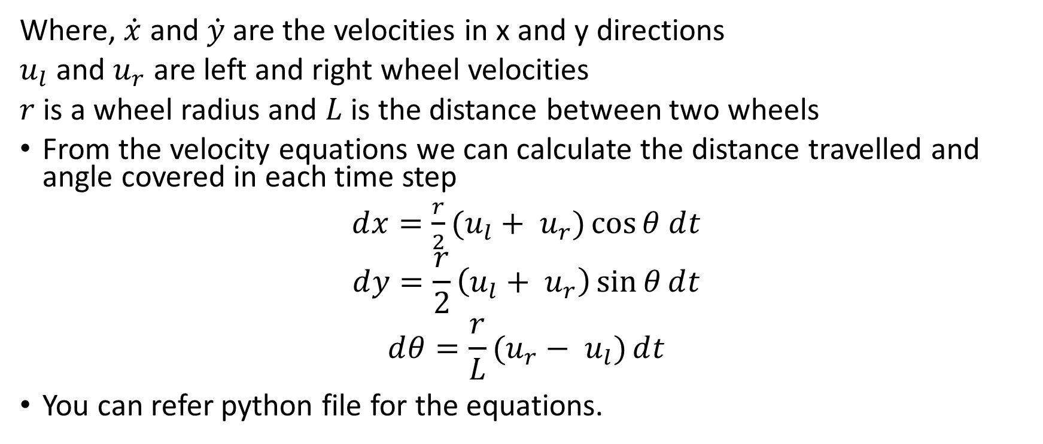
Differential Drive Constraints (Continued..)
Where, $\dot{x}$ and $\dot{y}$ are the velocities in x and y directions
$u_{l}$ and $u_{r}$ are left and right wheel velocities
$r$ is a wheel radius and $L$ is the distance between two wheels
From the velocity equations we can calculate the distance travelled and angle covered in each time step
$ⅆx=\frac{r}{2}(u_{l}+ u_{r})\cos{θ}$ $ⅆt$
$$ⅆy=\frac{r}{2}\left(u_{l}+ u_{r}\right)\sin{θ}ⅆt$$
$$ⅆθ=\frac{r}{L}(u_{r}− u_{l})ⅆt$$
You can refer python file for the equations.

Slide 13
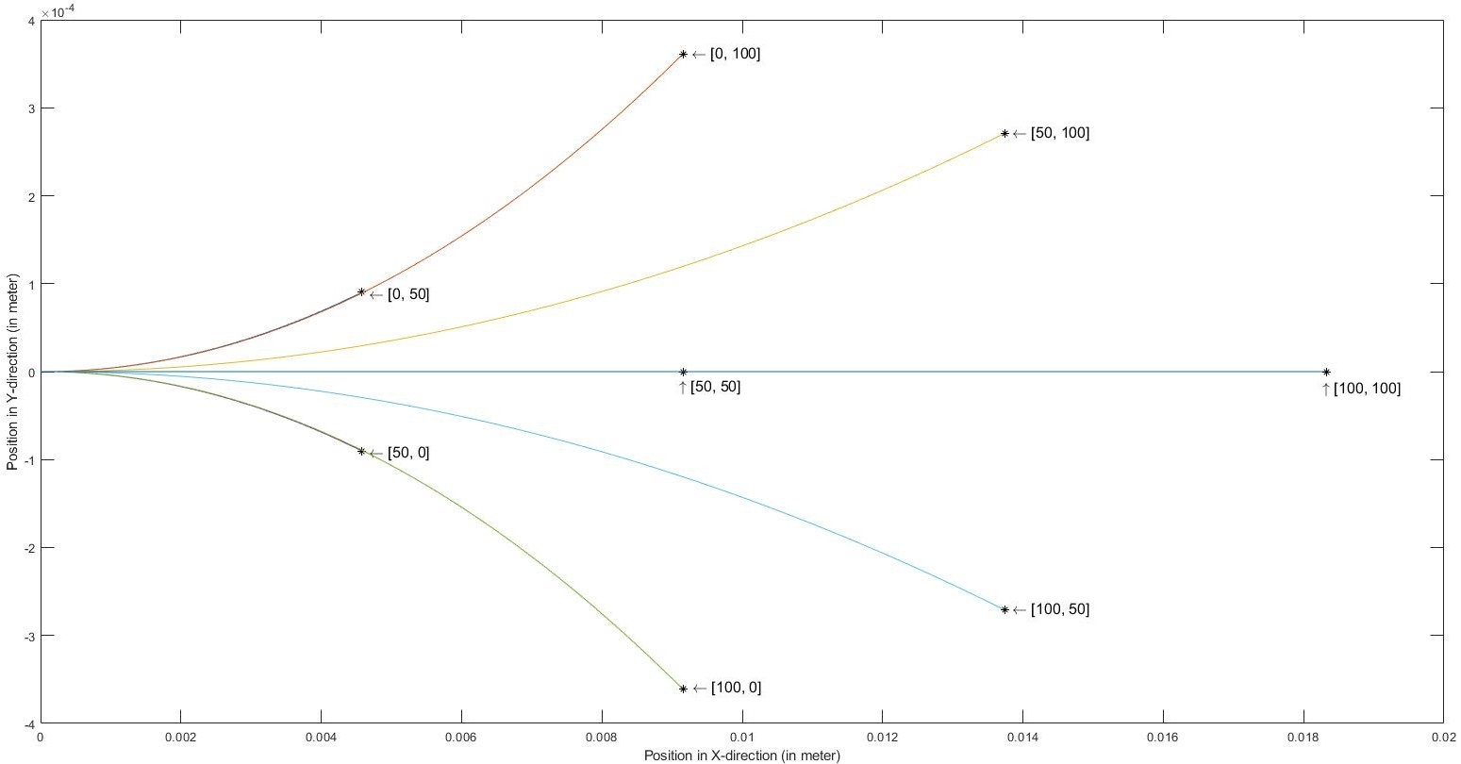
Differential Drive Constraints (Continued..)
The figure shows various curvatures obtained by changing left and right wheel velocities.

Slide 14
Step 2) Modify the map to consider the geometry of the rigid robot
Dimensions of the robot is available in the datasheet
The center circle is (0,0).

Slide 15
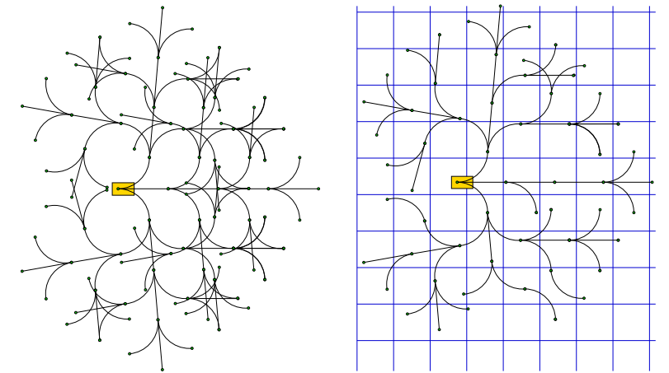
Step 3) Generate the tree using non-holonomic constraints
Consider the configuration space as a 3 dimensional space.
Follow the same step from Project 3- Phase 2 to check for duplicate nodes (consider threshold as per your own need, but make sure the 8-action space is not violated).

Slide 16
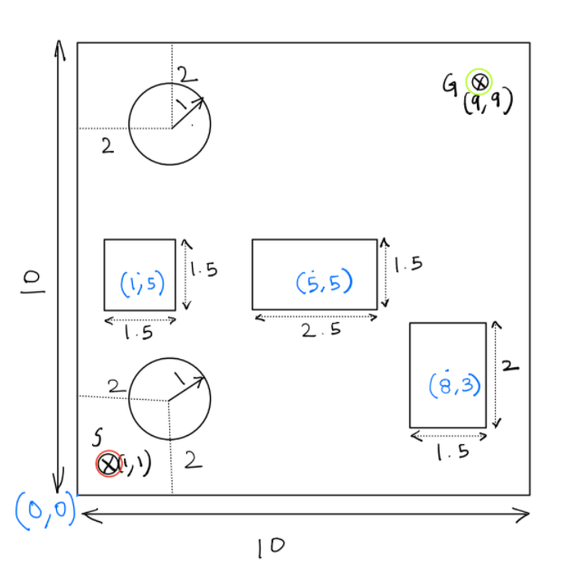
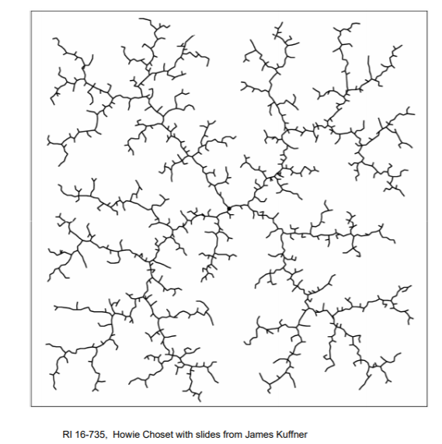
Step 4) Display the tree in the configuration space
Use curve that address the non-holonomic constraints to connect the new node to previous nodes and display it on the Map.

Slide 17
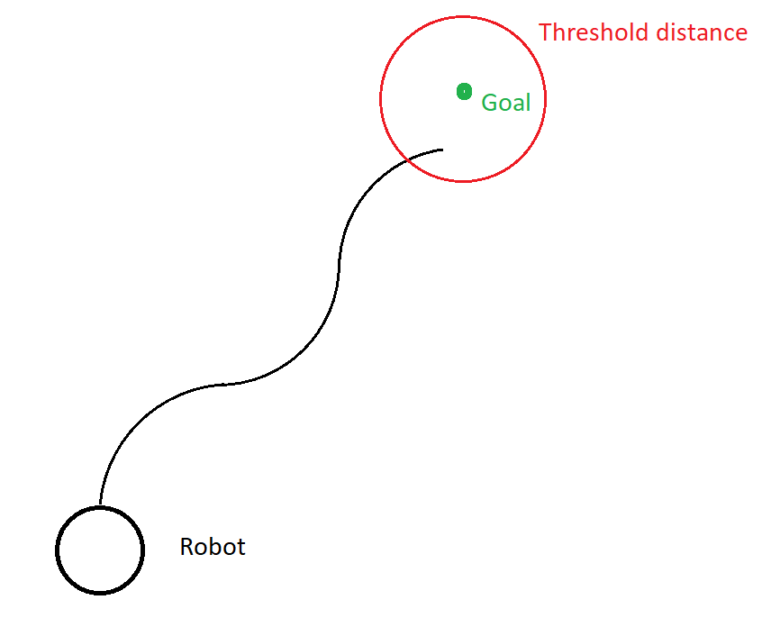
Step 5) implement A* search algorithm to search the tree and to find the optimal path
Consider Euclidean distance as a heuristic function.
Note - You must define a reasonable threshold value for the distance to the goal point. Due to the limited number of moves, the robot cannot reach the exact goal location, so to terminate the program a threshold distance must be defined.

Slide 18
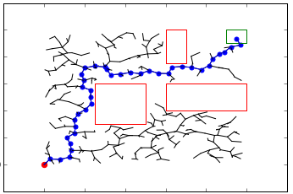
Step 6) Display the optimal path in the map
To plot the final path, you can use ‘quiver’ function as shown in plot_curve in the
shared python file (plot.py).

Slide 19
Video Submission – one video
Give a start point (bottom left) and end point (top right) such that almost all the nodes on the map are being explored.
Decide the clearance and wheel RPM’s on your own.
Mention all the user inputs in the ReadMe.

Slide 20
Part 2 description
Simulate the path planning implementation on Gazebo.
Gazebo environment has been provided for the map (map.world file)

Slide 21
Important pointers
To run the simulation in ROS, you should have everything wrapped in only one launch file.
Make note of the coordinate system in Gazebo, and the position of the origin. Input will be based on the coordinates in Gazebo.
User input should be from Terminal.
Only one person has to submit the final zip folder. Mention the other teammates in the comments section.
Mention the GitHub Repository's link in the comments section as well.

Slide 22
Helpful links for ROS
Writing a publisher/subscriber node –
http://wiki.ros.org/ROS/Tutorials/WritingPublisherSubscriber%28python%29
Initialize robot pose - https://answers.ros.org/question/40627/how-do-i-set-the-inital-pose-of-a-robot-in-gazebo/
Load custom Gazebo environment/ Creating ROS package - http://gazebosim.org/tutorials?tut=ros_roslaunch

Slide 23
Submission
The submission will be in two parts.
The Zip file should have two different folders for each part.

Slide 24
Submission Details Part 1
You are required to submit a zip file with the file structure as shown
proj3_groupnumber_simulationSoftware
code
simulation video
readme.txt
GitHub Link

Slide 25
Submission Details Part 2
There is weightage w.r.t to following instruction for folder name, directory structure, one launch file(ROS)/script (VREP) etc.
Source code
GitHub (one repository link only) and ReadMe
Simulation results (video of the simulation)
‘Video1’
‘Video2’
* Details for the videos are mentioned in the next slides

Slide 26
Video
The approximate start point is shown in red and goal point is shown in green.
The video should show the Turtlebot motion in Gazebo environment for these points.
Choose the points by your best judgment along with other user inputs.
You are not required to implement a controller, this will be open-loop and hence, it is okay if the robot does not follow the exact waypoints.

